Slide 1
Nicholas C. Smith-Washington
Old-field Succession

Slide 2
Notes:
Pristine Prairie with herbaceous asters

Slide 3
Notes:
Conifer forest

Slide 4
Notes:
Disturbance, Human use Exotic species invasion

Slide 5
Notes:
Deforestation, Clear Cutting, Lumbering, making way for farm land

Slide 6
Notes:
Stripped land, devastated species richness

Slide 7
Notes:
Example of change through time

Slide 8
Notes:
Modern agricultural plots

Slide 9
Notes:
The preparation of land for farm use

Slide 10
Notes:
The active use of land…

Slide 11
Notes:
Introduce dust bowl, Dirty Thirties

Slide 12
Notes:
The phenomenon was caused by severe drought combined with farming methods that did not include crop rotation, fallow fields, cover crops or other techniques such as soil terracing and wind-breaking trees to prevent wind erosion.

Slide 13
Notes:
Much of the soil ended up deposited in the Atlantic Ocean, carried by prevailing winds.

Slide 14
Notes:
Reduced availability of nutrients.

Slide 15
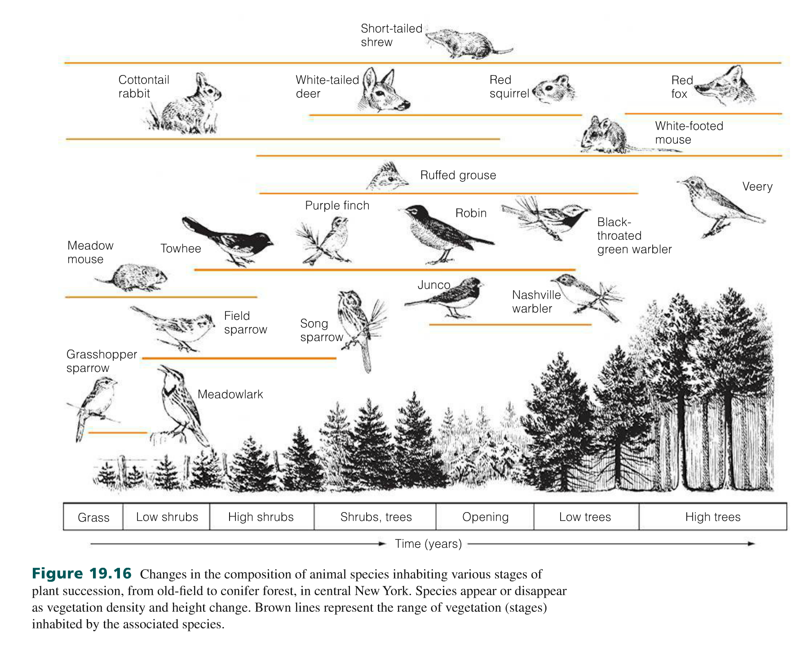
Notes:
Primary succession

Slide 16
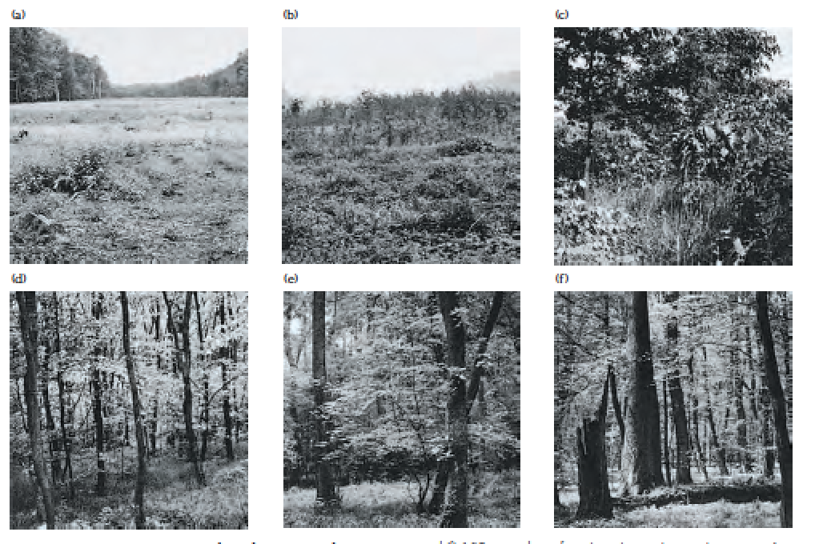

Slide 17
Notes:
Secondary Disruptive Event

Slide 18
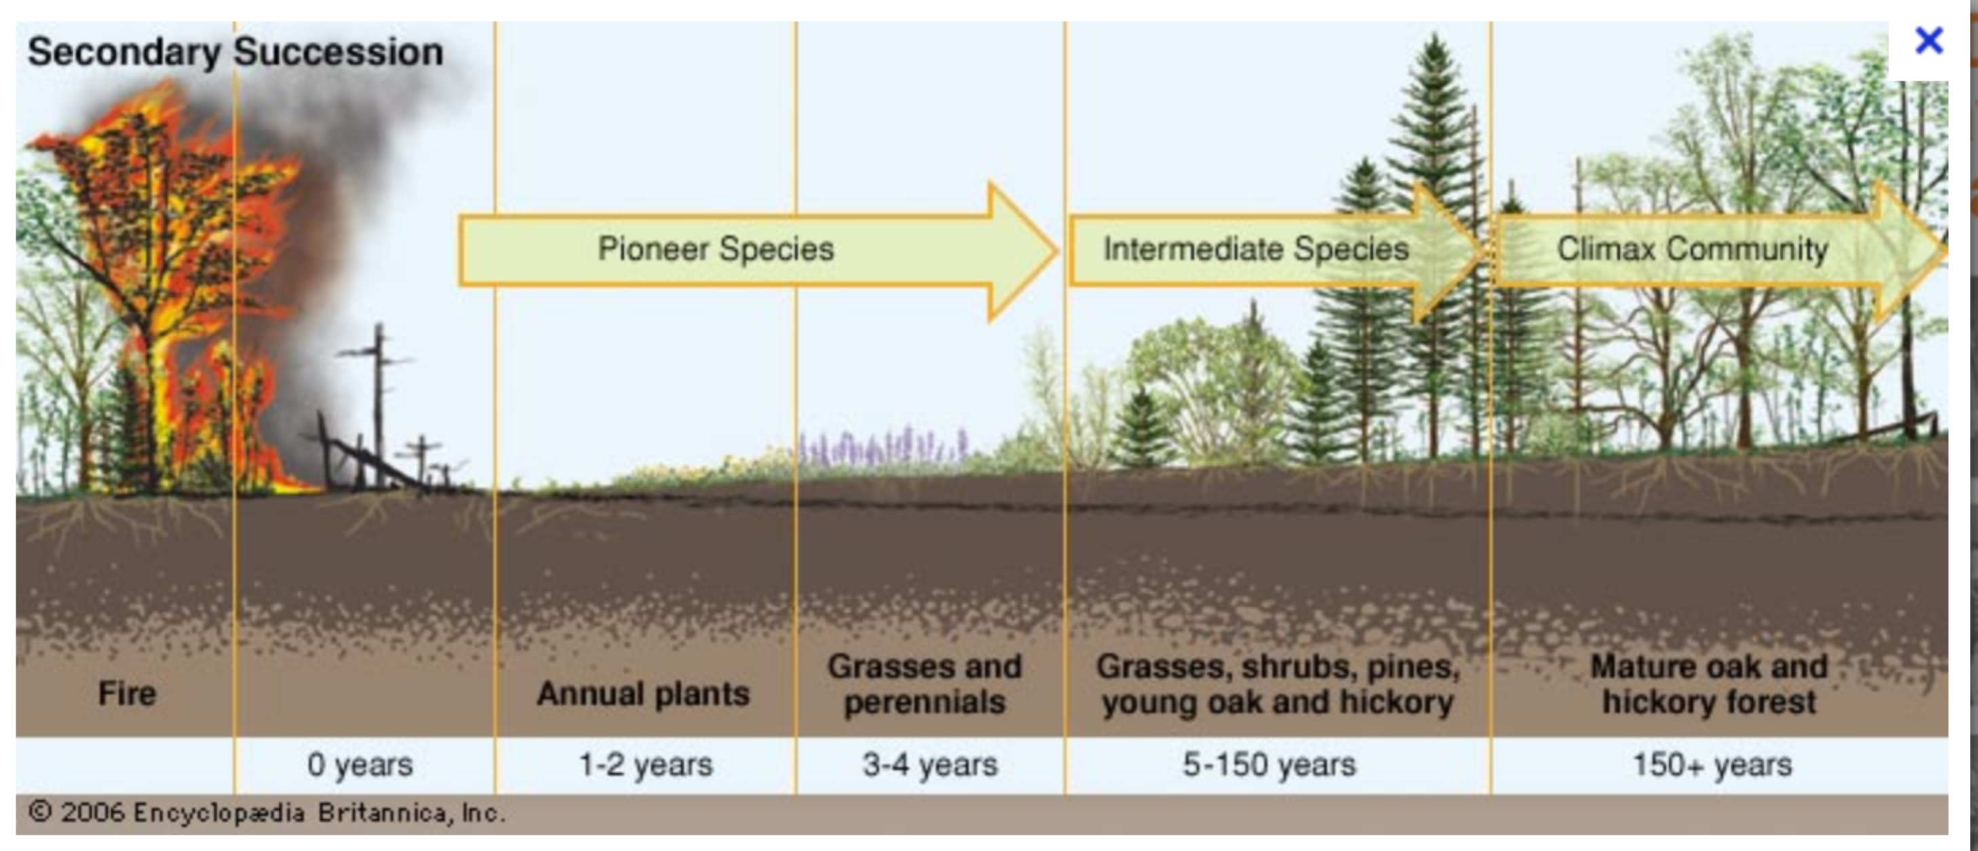

Slide 19
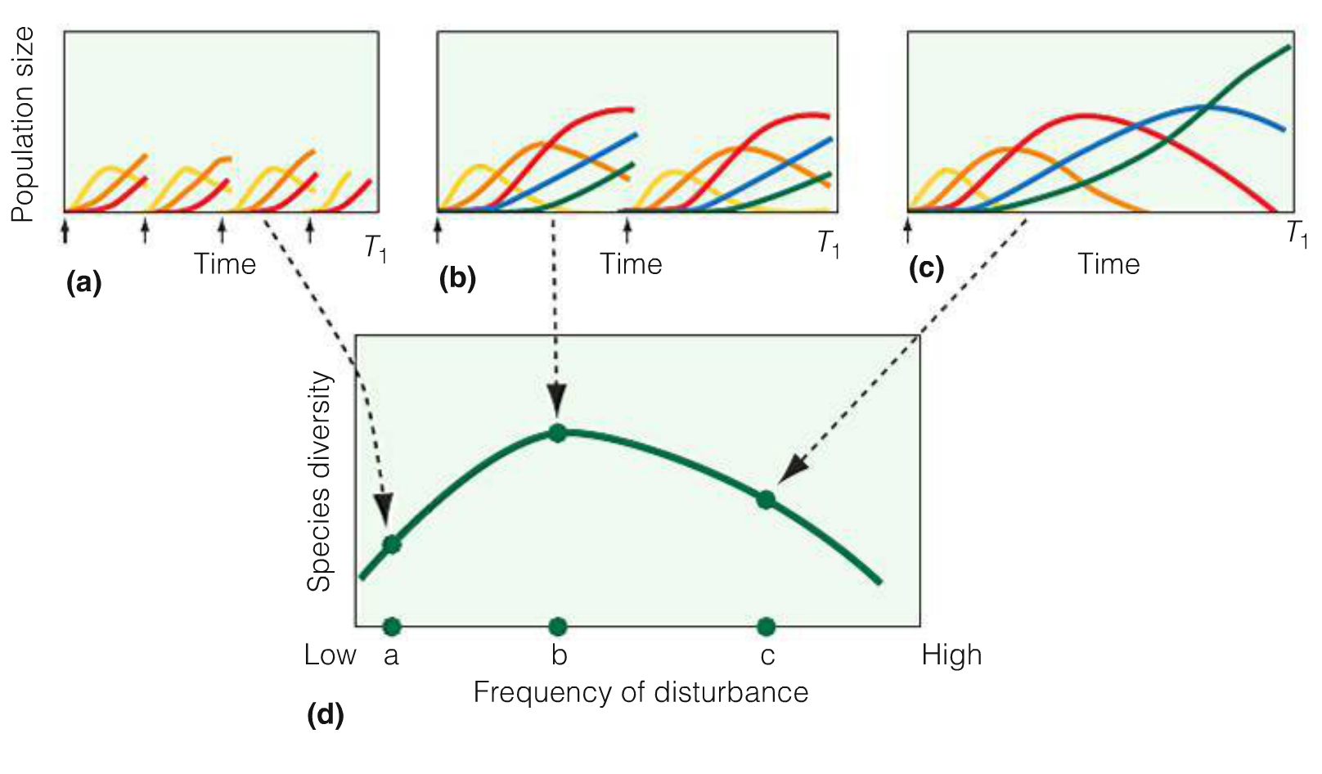
Notes:
At intermediate frequency
of disturbance. all species coexist. and
diversity is at a maximum

Slide 20
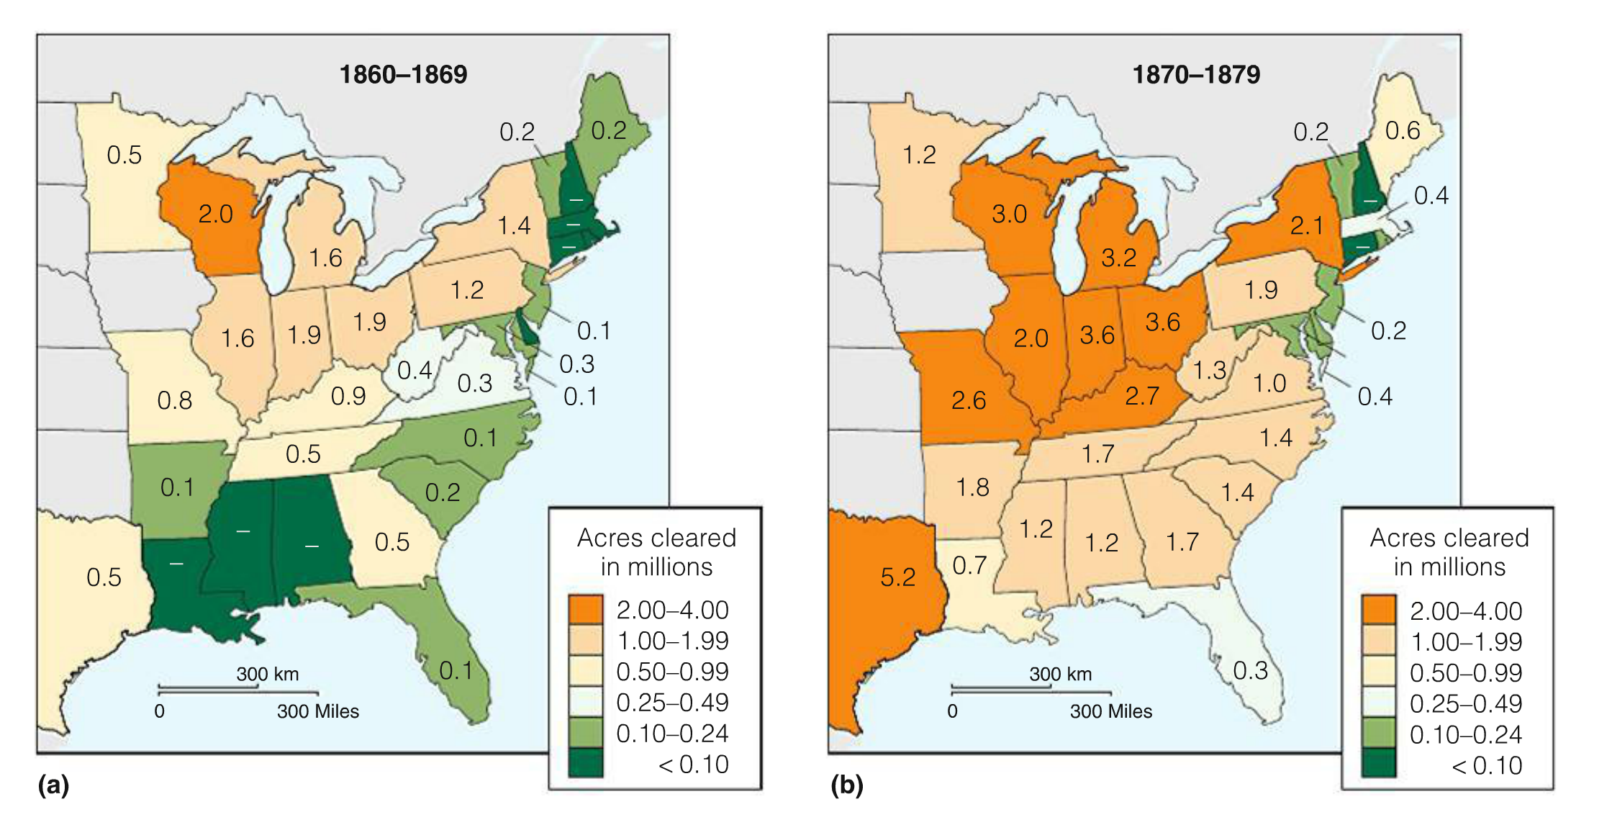

Slide 23
References
Meiners, S. J. 2007. Native and exotic plant species exhibit similar population dynamics during succession. Ecology 88:1098-1104.
Smith, T. M., and Robert Leo. Smith. Elements of Ecology. San Francisco: Pearson Benjamin Cummings, 2012. Print.
Baumeister, D., and R. M. Callaway. 2006. A hierarchy of mechanisms benefits other plant species. Ecology 87: 1816-1830.
Baumeister, D., and R. M. Callaway. 2006. Facilitation by pinus flexilis during succession: a hierarchy of mechanisms benefits other plant species. Ecology 87: 1816-1830.
Fortner, A. M., and J. F. Weltzin. 2007. Competitive hierarchy for four common old- field plant species depends on resource identity and availability. Journal of the Torrey Botanical Society 134:166-176.
Rudgers, J.A., J. Holah, S. P. Orr, and K. Clay. 2007. Forest succession suppressed by an introduced plant-fungal symbiosis. Ecology 88: 18-25.
Vile, D., B. Shipley, and E. Garnier. 2006. A structural equation model to integrate changes in functional strategies during old-field succession. Ecology 87: 504-517.

Slide 24
Questions?

